Slide 1
Theory of Cost
Short-run and Long-run Cost Curves

Slide 2
Cost Concept
It is used for analyzing the cost of a project in short and long run.
In other word, cost is the sum total of explicit cost & implicit cost.
Explicit cost is actual money expenditure or input or payment made to outsiders for hiring their factor services.
Implicit cost is the estimate value of inputs supplied by the owners including normal profit.

Slide 3
Cost Function
The Cost Function refers to the Mathematical relation between Cost of a Product and the various Determinants of Costs.
C = f(Q,T, P_{f}, K)
Where,
C = Total Cost
Q = Quantity Produced i.e. Output
T = Technology
P_{f} = Factor Price
K = Capital

Slide 4
Cost Function
Short Run Cost Function
C = f(Q)
Long Run Cost Function
C = f(Q,T, P,K)

Slide 5
Fixed Costs & Variable Costs
Fixed Costs require a Fixed Expenditure of Funds irrespective of the Level of Output e.g. Rent, Interest on Loans, Depreciation, etc.
Fixed Cost does not vary with the Volume of Output within a Capacity Level.
Fixed Cost may disappear on the Complete Shut Down of Business.
Variable Costs are costs that are a Function of Output in the Production Period e.g. Wages & Cost of Raw Materials.
Variable Costs vary Directly or sometimes Proportionately with Output.

Slide 6













Short Run Costs
Fixed Cost
Total Cost
Variable Cost

Slide 7
Short Run Fixed Cost (FC)
Fixed Costs are those costs which are of Independent Output i.e. they do not change with changes in Output.
They are a “Fixed Amount” incurred by the Firm, irrespective of Output.
In case of Firm Shut Down for some time, Fixed Costs are to be borne by the Firm.
For Example, Contractual Rent, Property Tax, Interest on Capital Employed, etc.

Slide 8
Short Run Variable Cost(VC)
Variable Costs are those costs which changes with changes in Output.
Includes Payments such as Wages of Labour, Price of Raw Material, etc.
In case of Firm Shut Down for some time, Variable Costs does not occur and hence avoided by the Firm.

Slide 9
Short Run Total Cost (TC)
Total Cost is defined as the Total Actual Cost that must be incurred to Produce a given Quantity of Output.
Total Costs is the sum of the Total Variable Costs and the Fixed Costs.
TC = TFC = TVC

Slide 10
Short Run Total Cost Curves
Y
Price Cost
TC
VC
FC
Fixed Cost
O
X
Output (Q)

Slide 11












Short Run Average Costs
Average Fixed Cost
Average Variable Cost
Average Total Cost

Slide 12
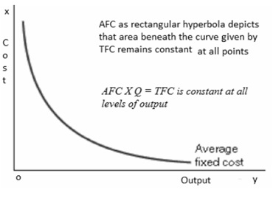

Short Run Average Fixed Cost (AFC)
Average Fixed Cost is Total Fixed Cost (TFC) divided by the Number of Units of Output Produced.
$$AFC=\frac{TFC}{Q}$$
Referred to as “Fixed Cost per unit of Output”.
AFC steadily falls as Output Increases
thereby, it slopes Downwards but does not touch X- Axis as AFC ≠ 0

Slide 13
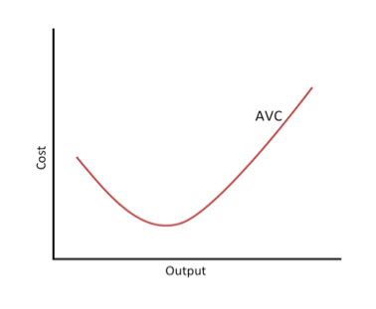

Short Run Average Variable Cost (AVC)
Average Variable Cost is Total Variable Cost
(TVC) divided by the Number of Units of Output Produced.
Cost per unit of
$$AVC=\frac{TVC}{Q}$$
Referred to as “Variable Output”.
AVC normally falls as Output Increases from O
to Normal Capacity of Output .

Slide 14
AVC normally falls as Output Increases from O to Normal Capacity of Output due to occurrence of Increasing Returns.
Beyond Normal Capacity of Output, AVC rises steeply as Diminishing Returns occurs.
AVC first Falls, reaches its Minimum and then rises again.

Slide 15
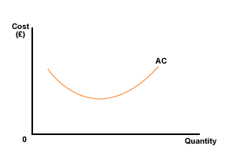
Short Run Average Total Cost (ATC)
Average Total Cost is the Sum Total of Average Variable Cost & Average Fixed Cost.
ATC = AFC + AVC
It is referred to as “Total Cost per unit of Output”.
Behaviour of ATC depends upon the
behavior of AVC & AFC.

Slide 16
Short Run Average Total Cost (ATC)
Since in beginning, Both AFC & AVC Falls, therefore, ATC Curve also falls.
When AVC ↑ , AFC ↓, ATC continues to fall as AFC > AVC.
As Output Increases, AVC ↑ and thus AVC > AFC and hence ATC ↑.
ATC is a “U” Shaped Curve.

Slide 17
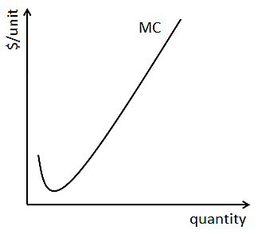
Short Run Marginal Cost (MC)
Marginal Cost is the addition made to the Total Cost by Production of an Additional Unit of Output.
MC = TCn – TCn-1
Marginal Cost is Independent of Fixed Cost.
As Marginal Product first rises, reaches maximum & then declines, thus, Marginal Cost first declines, reaches minimum & then rises.
MC curve of a Firm is “U” Shaped.

Slide 18
Short Run Average & Marginal Cost Curves
Y
Price Cost
MC ATC _{AVC}
AFC
X
O
Output (Q)

Slide 19
Relationship of MC & AC
When Marginal Cost is below Average Cost, it is pulling Average Cost down.
When Marginal Cost is above Average Cost, it is pulling Average Cost up.
When Marginal Cost just equals Average Cost, Average Cost is neither rising nor falling & is at its Minimum. Hence, at the bottom of a U-shaped Average Cost, MC = AC = Minimum AC.

Slide 20
Long Run Average Cost Curve
Long Run is a period of Time during which the Firm can vary all of its Inputs.
The Firm moves from one plant to another in Long Run. To Increase the Output, Firm acquires Big Plant & vice versa.
Long Run Cost of Production is the least possible Cost of Producing any given level of Output when all Individual Factors are Variable.
The Minimum Point on LRAC Curve is the “Minimum Efficient Scale”.

Slide 21
Short Run Average Cost Curves deriving Long Run Average Cost Curves
Y
SAC₂
Average Cost
SAC
SAC₃
1
H
J
R
Q
L
K
O
X
A B C
D
Output (Q)

Slide 22
Long Run Average Cost Curve
Y
SAC₁
SAC
Average Cost
7
SAC₂
LAC
SAC
SAC₃
SAC₅
6
SAC₄
F
G
T
K H
P
O
X
M N V
Q
W
Output

Slide 23
Long Run Average Cost Curve
Long Run Cost Curve depicts the Functional relationship between Output & the Long Run Cost of Production.
It envelopes the set of U-Shaped Short-Run Average Cost Curves Corresponding to different Plant Sizes.
LRAC Curve is “U-Shaped”, reflecting Economies of Scale (or Increasing Returns to Scale) when Negatively Sloped and Diseconomies of Scale (or Decreasing Returns to Scale) when Positively Sloped.

Slide 24
Long Run Average Cost Curve
Every Point on the Long Run Average Cost Curve is a Tangency Point with some Short Run AC Curve.
LAC Curve is not a Tangent to the minimum points of the SAC Curves.
LAC Curve is called as “Planning Curve” as a Firm Plans to Produce any Output in the Long Run by choosing a Plant on the Long Run Average Cost Curve corresponding to the given output.

Slide 25
Long Run Cost Curve
All costs are variable in the long run. There is only AVC in LR, since all factors are variable. Long Run Cost Curve
Economies of Scale: Economies of scale are the cost advantages that a firm obtains due to expansion. Diseconomies is the opposite.
Two types:
1. Pecuniary Economies of Scale: Paying low prices because of buying in large Quantity.
2.Real Economies of Scale: Refers to reduction in physical quantities of input , per unit of output when the size of the firm increases, as a result input cost minimized.
Internal Economies: It is a condition which brings about a decrease in LRAC of the firm because of changes happening within the firm. External Economies: It is a condition which brings about a decrease in LRAC of the firm because of changes happening outside the firm. E.g. Taxation policies of government Diseconomies

Slide 26
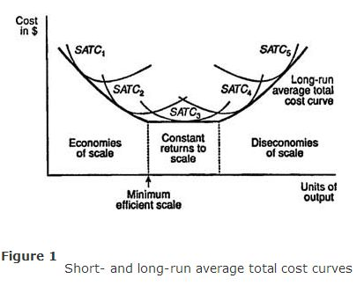
Long run cost curve

